Slide 1
Tutorial 4 Group C10
17th September 2018
Joanne Ong

Slide 2
Plans for today
Pre-mid recap
Problem 10.1
Problem 10.2
Problem 11.1
Problem 11.2
Problem 11.3
Problem 12.1
Review: AS01
Notes:
Today, we will be

Slide 3
Pre-mid recap Kahoot
https://bit.ly/2NhIh8P
Notes:
(15 mins)

Slide 4
Pre-mid recap Kahoot
Where will you always end up in if you typed `cd ..` in your terminal?

Slide 5
Pre-mid recap Kahoot
Answer:
In the parent directory

Slide 6
Pre-mid recap Kahoot
What does the command `clang –o hello.c hello` do?

Slide 7
Pre-mid recap Kahoot
Answer:
Overwrite your code in hello.c

Slide 8
Pre-mid recap Kahoot
What does the following recursive function mystery do?
mystery(L, i, j) is either:
l_{i} if i equals j
or
l_{i} + mystery(L, i+1, j) if j > i

Slide 9
Pre-mid recap Kahoot
Answer:
Sum all integers in a given list L

Slide 10
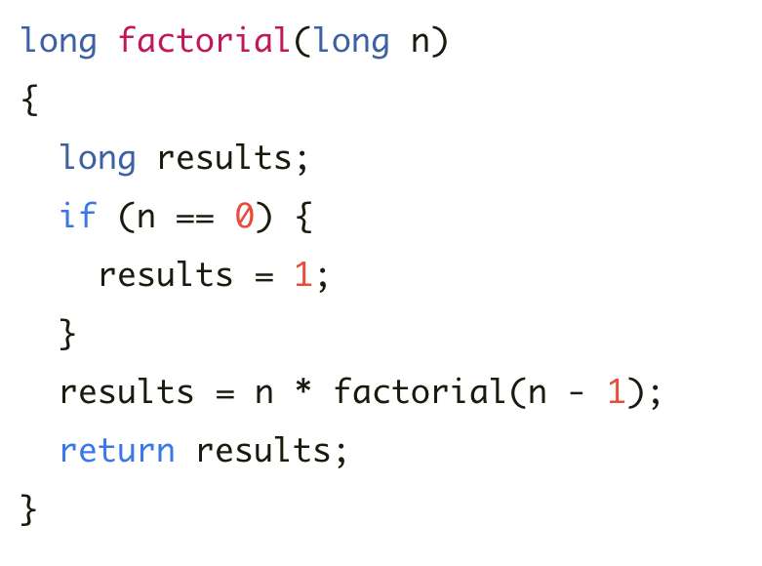
Pre-mid recap Kahoot
What is wrong with the following program?

Slide 11
Pre-mid recap Kahoot
Answer:
It will never terminate!

Slide 12
Pre-mid recap Kahoot
When and where will midterms be held for CS1010 this year?

Slide 13
Pre-mid recap Kahoot
Answer:
2nd October, MPSH

Slide 14
Problem 10.1 (a)
Negate the following logical expression, then apply De Morgan's Law to simplify the resulting expression.
(x > 1) && (y != 10)
Notes:
(5 mins) – everyone in the class is taking CS1231
Can someone try this?
(x <= 1) || (y == 10)

Slide 15
Problem 10.1 (a)
!((x > 1) && (y != 10))
→ !(x > 1) || !(y != 10)
→ (x <= 1) || (y == 10)
Notes:
(5 mins)

Slide 16
Problem 10.1 (b)
Negate the following logical expression, then apply De Morgan's Law to simplify the resulting expression.
!eating && drinking
Notes:
Eating || !drinking

Slide 17
Problem 10.1 (b)
!(!eating && drinking)
→ (eating || !drinking)

Slide 18
Problem 10.1 (c)
Negate the following logical expression, then apply De Morgan's Law to simplify the resulting expression.
(has_cs2030 || has_cs2113) && has_cs2040c
Notes:
(!has_cs2030 && !has_cs2113) || !has_cs2040c

Slide 19
Problem 10.1 (c)
!((has_cs2030 || has_cs2113) && has_cs2040c)
→ !(has_cs2030 || has_cs2113) || !has_cs2040c
→ !(has_cs2030 || has_cs2113) || !has_cs2040c
→ (!has_cs2030 && !has_cs2113) || !has_cs2040c

Slide 20
Problem 10.2
long score = 4;
if (something) {
score = 10;
} else {
score = 0;
}
// { ??? }
if (score == 4) {
score = 1;
} else {
score += 10;
}
// { ??? }
if (score >= 10) { cs1010_println_string("ok");
} else {
cs1010_println_string("failed");
}
Notes:
(5 mins)

Slide 21
Problem 10.2
long score = 4;
if (something) {
score = 10;
} else {
score = 0;
}
// { score == 10 || score == 0 }
if (score == 4) {
score = 1;
} else {
score += 10;
}
// { ??? }
if (score >= 10) { cs1010_println_string("ok");
} else {
cs1010_println_string("failed");
}
Notes:
(5 mins)

Slide 22
Problem 10.2
long score = 4;
if (something) {
score = 10;
} else {
score = 0;
}
// { score == 10 || score == 0 }
if (score == 4) {
score = 1;
} else {
score += 10;
}
// score is never 4! So we always execute the false block. // { score == 20 || score == 10 }
if (score >= 10) {
cs1010_println_string("ok");
} else {
cs1010_println_string("failed");
}
Notes:
(5 mins)

Slide 23
Problem 10.2
long score = 4;
if (something) {
score = 10;
} else {
score = 0;
}
// { score == 10 || score == 0 }
if (score == 4) {
score = 1;
} else {
score += 10;
}
// score is never 4! So we always execute the false block.
// { score == 20 || score == 10 }
// Now, score is always >= 10, and "ok" will always be printed.
if (score >= 10) {
cs1010_println_string("ok");
} else {
cs1010_println_string("failed");
}
Notes:
(5 mins)

Slide 24
Problem 11.1
long factorial(long n) {
long i = n - 1;
long product;
for (product = n; i >= 2; product *= i)
{
i -= 1;
}
return product;
}
Notes:
(5 mins)
Is this correct? (NO!)
Let’s trace through with an example. Factorial(4)

Slide 25
Problem 11.1
factorial(4)
1. i = 3; product = 4; (initialization)
2. i -= 1; (i = 2)
3. product *= i;
(product becomes 8)
4. i >= 2? (yes)
5. i -= 1; (i == 1)
6. product *= i;
(product becomes 8).
7. i >= 2? (no)
long factorial(long n) {
long i = n - 1;
long product;
for (product = n; i >= 2; product *= i)
{
i -= 1;
}
return product;
}
Notes:
(5 mins)
Is this correct? (NO!)
How can we fix this?

Slide 26
Problem 11.1
long factorial(long n) {
int i = n+1;
long product;
for (product = 1; i >= 2; product *= i)
{
i -= 1;
}
return product;
}
Notes:
(5 mins)
There are many fixes that are possible for this question. This is just one of the possible fixes.

Slide 27
Problem 11.2 (a)
Rewrite the "Guess A Number" program so that it shows the user the number of guesses made before the correct guess is entered.
long guess;
do {
guess = cs1010_read_long();
if (guess > answer) {
cs1010_println_string("too high");
} else if (guess < answer) {
cs1010_println_string("too low");
}
} while (guess != answer);
cs1010_println_string("you got it. congrats!");
Notes:
(15 mins)
Try to get at least 2 different answers from students.
Here is part of the code.

Slide 28
Problem 11.2 (a)
long count = 0;
do {
cs1010_println_long (count);
guess = cs1010_read_long();
count += 1;
if (guess > answer) {
cs1010_println_string("too high");
} else if (guess < answer) {
cs1010_println_string("too low");
}
} while (guess != answer);

Slide 29
Problem 11.2 (b)
Rewrite the "Guess A Number" program with a while loop.
long guess;
do {
guess = cs1010_read_long();
if (guess > answer) {
cs1010_println_string("too high");
} else if (guess < answer) {
cs1010_println_string("too low");
}
} while (guess != answer);
cs1010_println_string("you got it. congrats!");
Notes:
Do-while guarantees that the body of the loop will execute at least once

Slide 30
Problem 11.2 (b)
guess = cs1010_read_long();
if (guess > answer) {
cs1010_println_string("too high");
} else if (guess < answer) {
cs1010_println_string("too low");
}
while (guess != answer) {
guess = cs1010_read_long();
if (guess > answer) {
cs1010_println_string("too high");
} else if (guess < answer) {
cs1010_println_string("too low");
}
}
Notes:
This is a possible way since it guarantees that the body is executed at least once.
Can you make this more concise?

Slide 31
Problem 11.2 (b)
guess = cs1010_read_long();
if (guess > answer) {
cs1010_println_string("too high");
} else if (guess < answer) {
cs1010_println_string("too low");
}
while (guess != answer) {
guess = cs1010_read_long();
if (guess > answer) {
cs1010_println_string("too high");
} else if (guess < answer) {
cs1010_println_string("too low");
}
}
duplicated below
Notes:
This is a possible way since it guarantees that the body is executed at least once.
Can you make this more concise?

Slide 32
Problem 11.2 (b)
guess = cs1010_read_long();
while (guess != answer) {
if (guess > answer) {
cs1010_println_string("too high");
} else if (guess < answer) {
cs1010_println_string("too low");
}
guess = cs1010_read_long();
}

Slide 33
Problem 11.2 (c)
Extend the "Guess A Number" program so that it plays the game for five rounds with the user, and at the end, shows the user the average number of guesses over five rounds. (Hint: you should put the loop that reads the guess and prints feedback to the user into another function.)
Notes:
Let’s start by making it into a function.

Slide 34
Problem 11.2 (c)
Hint: Let’s make this into a function
long guess_a_number() {
long answer = (random() % 100) + 1;
long guess;
long count = 0;
do {
guess = cs1010_read_long();
count += 1;
if (guess > answer) {
cs1010_println_string("too high");
} else if (guess < answer) {
cs1010_println_string("too low");
}
} while (guess != answer);
cs1010_println_string("you got it. congrats!");
return count;
}
Notes:
What can we do next?

Slide 35
Problem 11.2 (c)
Now, we can just use an outer loop:
count = 0;
for (i = 0; i < 4; i += 1) {
count += guess_a_number();
}
cs1010_println_double(count/5.0);
Notes:
This question shows how writing functions can really help in nested loops.
Otherwise, you can imagine the mess.

Slide 36
Problem 11.2 (d)
What is the optimal strategy to play the game?
I am thinking of a number between 1 and 100…
Notes:
Any ideas?
Let’s test it out!

Slide 37
Problem 11.2 (d)
Prelude to binary search
halve the region of numbers that contain the search
only need log(n) guesses!

Slide 38
Problem 11.3 (a)
long mystery(long n, long k) {
long something = n;
long count = -1;
while (something >= 1) {
something /= k;
count += 1;
}
return count;
}
Notes:
(5 mins)
OK so we have a mystery function here.

Slide 39
Problem 11.3 (a)
long mystery(long n, long k) {
long something = n;
long count = -1;
while (something >= 1) {
something /= k;
count += 1;
}
return count;
}
n is 8 and k is 2?
count = 3
n is 81 and k is 3?
count = 4
n is 100 and k is 5?
count = 2
Notes:
What should we get as output when n is 8 and k is 2?
What about when n is 81 and k is 3?
What about when n is 100 and k is 5?

Slide 40
Problem 11.3 (b)
What is the mathematical expression that our mystery function here is trying to compute based on the examples above?
floor(log_{k}(n))

Slide 41
Problem 11.3 (c)
Give a pair of inputs that would cause the function to return the wrong answer.
long mystery(long n, long k) {
long something = n;
long count = -1;
while (something >= 1) {
something /= k;
count += 1;
}
return count;
}
Notes:
If n = 0, the value returned would be -1 even though it should be undefined.

Slide 42
Problem 11.3 (c)
Give a pair of inputs that would cause the function to return the wrong answer.
long mystery(long n, long k) {
long something = n;
long count = -1;
while (something >= 1) {
something /= k;
count += 1;
}
return count;
}
What happens if n = 0?
Notes:
If n = 0, the value returned would be -1 even though it should be undefined.

Slide 43
Problem 11.3 (d)
Give a pair of inputs that would cause the function to loop forever.
long mystery(long n, long k) {
long something = n;
long count = -1;
while (something >= 1) {
something /= k;
count += 1;
}
return count;
}
Notes:
If k is 1, then something over k never changes, so it would loop forever (it should be undefined).

Slide 44
Problem 11.3 (d)
Give a pair of inputs that would cause the function to loop forever.
long mystery(long n, long k) {
long something = n;
long count = -1;
while (something >= 1) {
something /= k;
count += 1;
}
return count;
}
What happens if k = 1?
Notes:
f k is 1, then something over k never changes, so it would loop forever (it should be undefined).

Slide 45
Problem 12.1 (a)
Trace through the program. What is the value of j when the loop exits?
long i = 10;
long j = 0;
while (i != 0) {
i -= 1;
j += 1;
}
Notes:
The value of j is 10.

Slide 46
Problem 12.1 (b) + (c)
What is the pattern/ loop invariant?
long i = 10;
long j = 0;
while (i != 0) {
i -= 1;
j += 1;
}
Notes:
The loop invariant is { i + j === 10 }

Slide 47
Problem 12.1 (b) + (c)
long i = 10;
long j = 0;
// { i + j == 10 }
while (i != 0) {
i -= 1;
j += 1;
// { i + j == 10 }
}
// { i == 0 }
// { i + j == 10 }
// so { j == 10 }
Notes:
You can also think about the loop invariant by looking at it before the look, during the loop, and after the loop.

Slide 48
AS01
Still grading…
Notes:
I will be looking through each and every assignment, and giving feedback and comments for it. I am not sure when they will release the grades to you though…
But because assignment 2 is already out, let’s go through some common mistakes and make sure to avoid these in assignment 2.

Slide 49
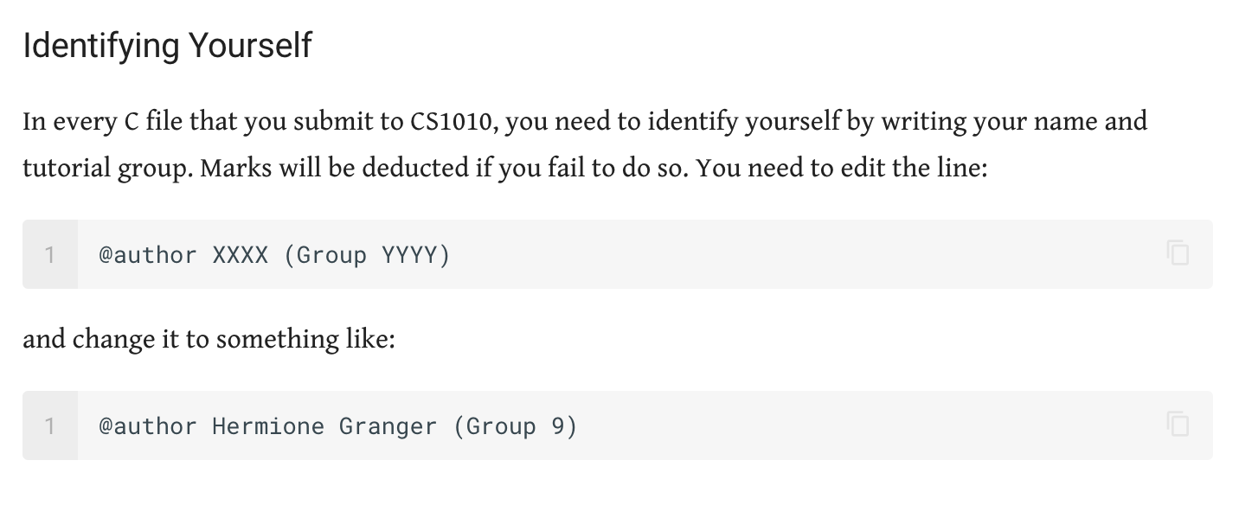
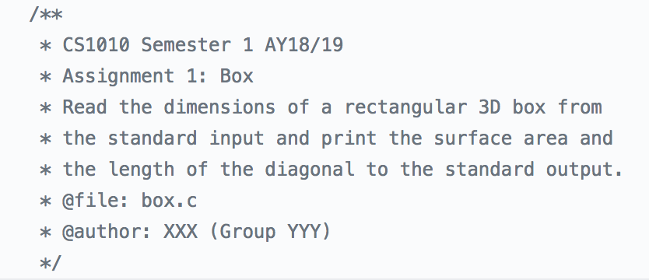
AS01: General Comments
Incomplete identification…
Notes:
Which group are we??
Don’t lose marks over this!!

Slide 50
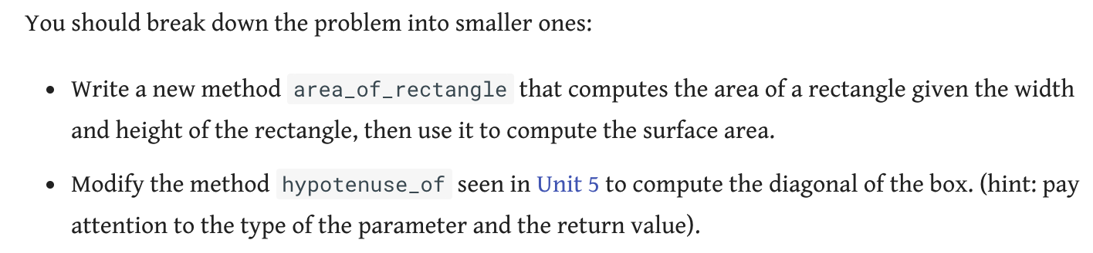
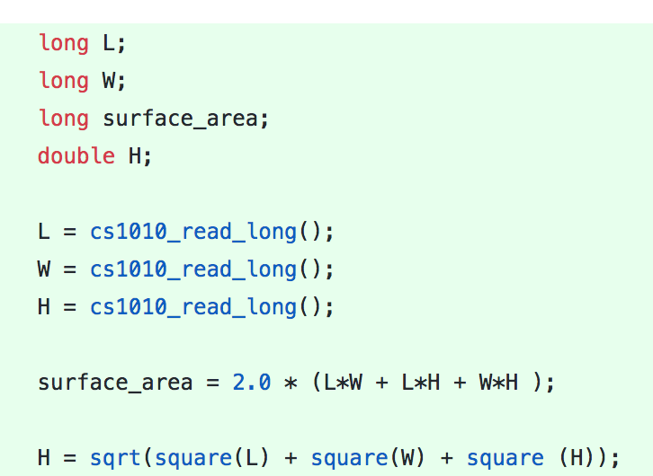
AS01: General Comments
Missing required functions…

Slide 51
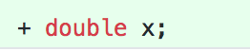
AS01: General Comments
Unused variables…

Slide 52
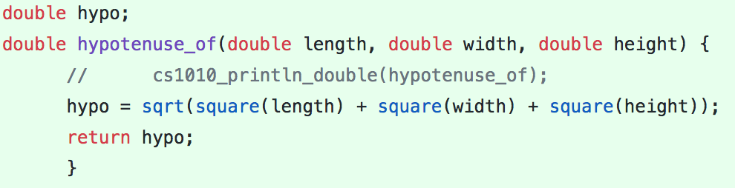
AS01: General Comments
Global variables…

Slide 53
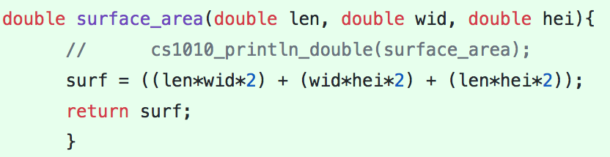
AS01: General Comments
Wrong choice of types…
- Only use double when needed (integer division)
- Don’t use int - will cause errors in some programs

Slide 54
AS01: General Comments
Be careful not to submit past the deadline – submission time is logged and checked!
But you can resubmit as many times as you like before the deadline…

Slide 55
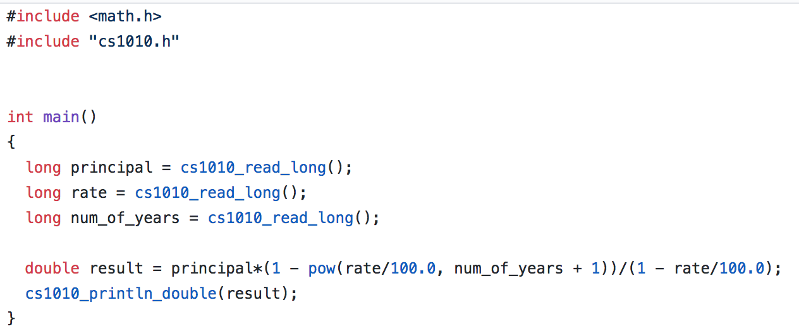
AS01: invest.c
Notes:
Test arithmetic operations

Slide 56
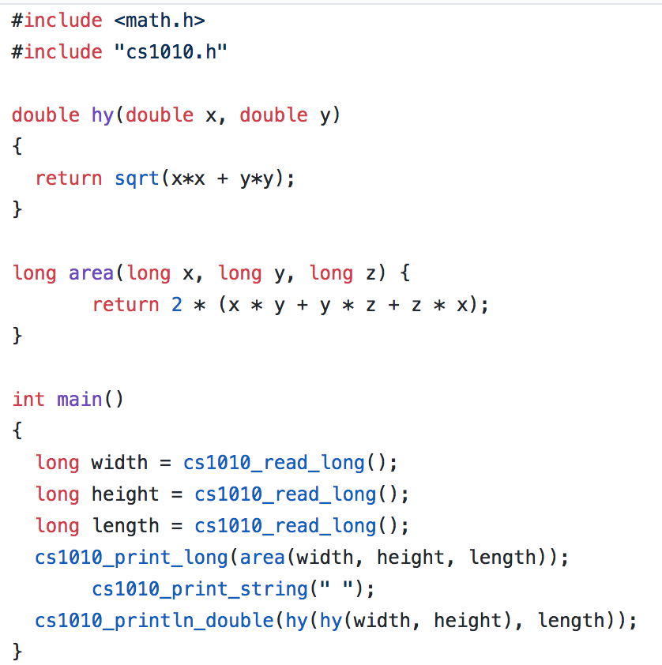
AS01: box.c
Notes:
Test writing functions

Slide 57
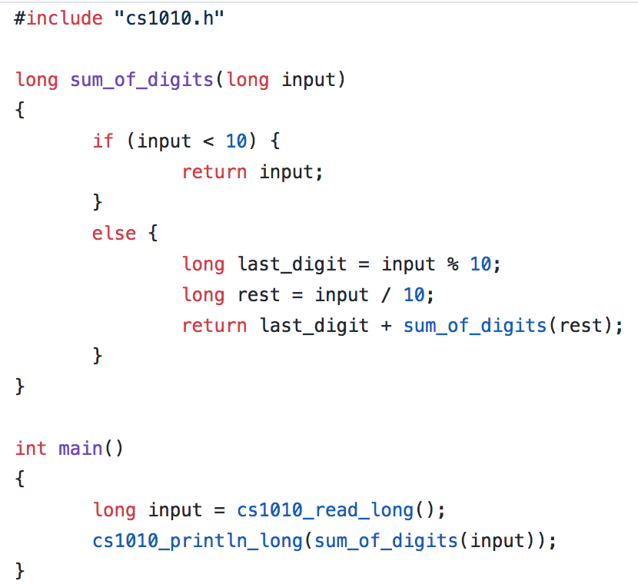
AS01: digits.c
Notes:
Test concept of recursion

Slide 58
AS01: taxi.c

Slide 59
AS01: taxi.c

Slide 60
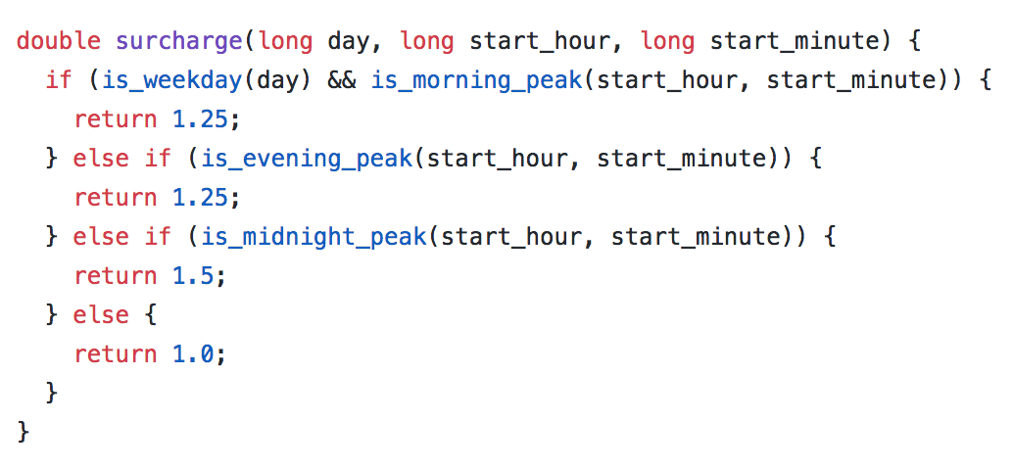
AS01: taxi.c

Slide 61
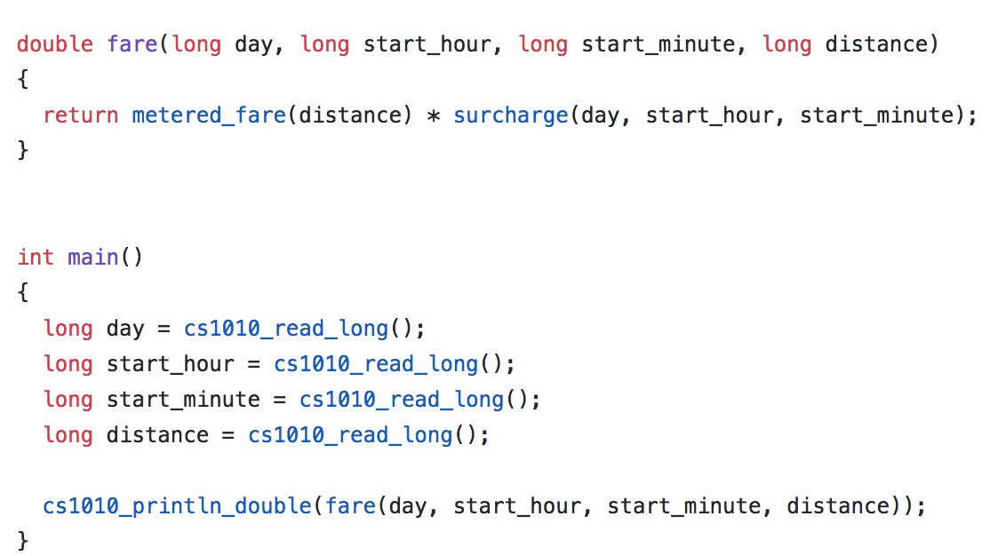
AS01: taxi.c

Slide 62
Any Questions?

